Slide 1

SRM INSTITUTE OF SCIENCE AND TECHNOLOGY
FACULTY OF ENGINEERING AND TECHNOLOGY
DEPARTMENT OF NETWORKING AND COMMUNICATIONS
18CSC101J- MINI PROJECT
CONTACT MANAGEMENT SYSTEM
By
ARYAN CHAUDHARY[RA2111026010077]
Branch/Section: CSE-AI & ML/T1
Batch No:1
Lab Instructor name: Dr.R.Kayalvizhi

Slide 2
Table of Content
Introduction
Materials and Methods
Algorithms
Snapshots
Conclusion
Future scope

Slide 3
Contact Management System
Introduction
In “CONTACT MANAGEMENT SYSTEM” we have done system design, source coding, and program testing and added many more features to facilitate the user with the best. We have given the user the facility to enter the person’s record and providing the option to save and delete that record and many more options.
We can improve the efficiency of the system, thus overcome the drawbacks of the existing system.
Less human error
Strength and strain of manual labour can be reduced
High security
Data consistency
Easy to handle
Easy data updating
Easy record keeping
Backup data can be easily general

Slide 4
Contact Management System
Materials
And Methods
The Title of the Program is to develop a program which deals with the combination of structures, arrays, File pointers and other functions. This program could do some operations on arrays such as insertion, deletion, sorting, searching, update, retrieve, merging, append,exit.
By implementing this program we can execute the inserted contact data, deletion of the data, searching, updating, append, exit with numbers by using arrays and file pointers. This program is implemented for only numbers that can enter into an array. To do this analysis manually it takes a lot of time and patience but by implementing this program it becomes much easier.
.The following steps are followed while implementing the given program using if and while loop.
The input is entered i.e., the value of choice (the menu no) select the particular menu.
Next it goes to particular menu and then goto the particular function.
It prints the resultant value which came from the execution.
The outcome of the work is one can get the required changes like inserting or deleting or sorting or merging or append or retrieve or update or exit for a given array.

Slide 5
Contact Management System
AIM:
To develop a “Phonebook contact” application using c programming.
This program is very useful now-a-days to store complete information under single contact number.
This program also has options to deletion and modification of the entered contact number.
Advantages:
It becomes easy for the user to store complete information (e-mail id, address, e.t.c) about his contact.
It is easy for the user to just search his required contact number by just typing name of the contact.
Disadvantages:
Sometimes it becomes difficult to store more contacts (over 150).
Future Enhancements:-
It becomes even difficult to store contacts with two or more contact numbers
SOFTWARE REQUIREMENTS:
This application is developed in Microsoft windows xp or later operating system.
This Phonebook application is coded and made using the following compilers:
Code::blocks.
Turbo c.

Slide 6
Contact Management System
HARDWARE REQUIREMENTS:
This Application size is 33Kb and the size of the code is 5Kb so such amount of memory is required from hard disk.
RAM: minimum 256MB. ouse, keyboard.
• M

Slide 7
Contact Management System
ALGORITHM:
Start.
Display the options on the screen.
Read name, address, father name, mother name, mobile number, gender.
Print “WELCOME TO CONTACT MANAGEMENT SYSTEM” and “Menu” on the screen
Add contact
Print all contacts
Modify contacts
Search contact
Delete contact
Close phone book
Now for Addrecord(),arranging data as Enter name ,Enter address ,Enter phone no, Email ID and finally operations record saved ,Enter any key.
Now for listrecord(),arranging data as
if data is empty print file opening error in listing
Elseprint your record: name,address,mobile no, Email ID
After all these print enter any key
Now for searchrecord(),arranging data as
if data is insufficient print error in opening
Else
print enter name of contact to be searched and
If (strcmp(p.name,name)==0)
print detail information about name and name,address,mobilenum, Email.
After entering all these, print enter any key
Now for deleterecord(),arranging the data as
If (f==null)
print contact’s data not added yet
else
if(f==null)

Slide 8
Contact Management System
print file opening error
Else
Print enter contact’s details.
if (flag!=1)
print no contact’s record to delete
Else
print record deleted successfully
After entering all the data print enter any key 10.for modifyrecord(),arranging the data as
If (f==null)
print contact’s data not added yet
Else
enter contact’s name to modify
Print enter name , enter address ,mobile number, Email after entering the data
print your data is modified
Else
print data is not found
Finally print enter any key. 11.Redisplay the menu for user required input.

Slide 9
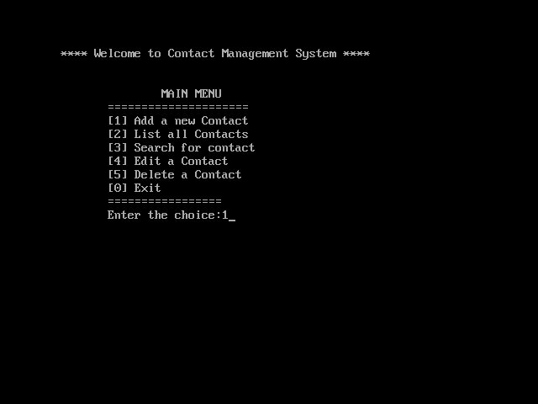
Contact Management System
SCREENSHOTS:
Fig 3.1 Main Menu

Slide 10
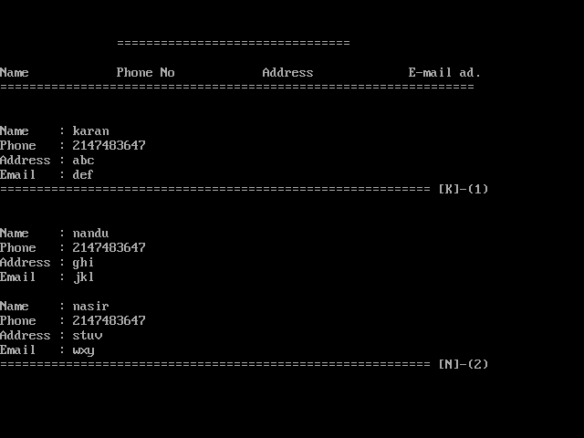
Contact Management System
Fig 3.2 Adding of Contacts

Slide 11
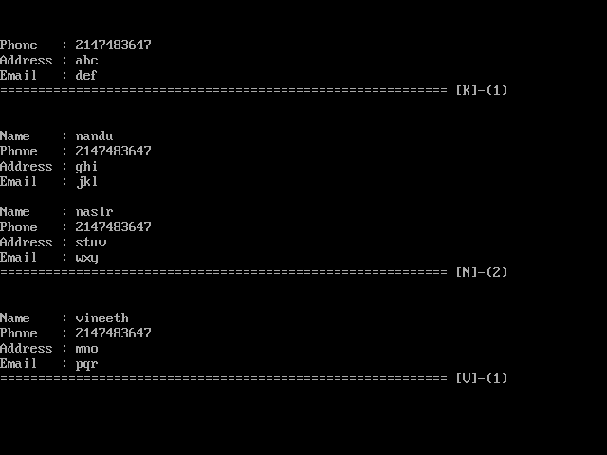
Contact Management System
Fig 3.2.1 Adding of contacts

Slide 12
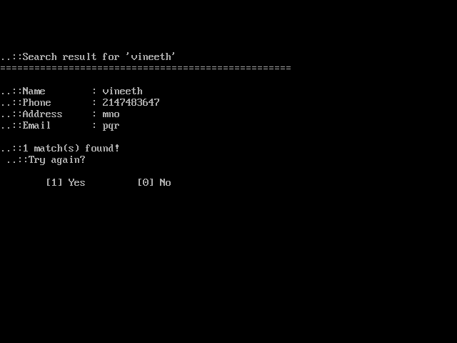
Contact Management System
Fig 3.3 Searching a Contact

Slide 13
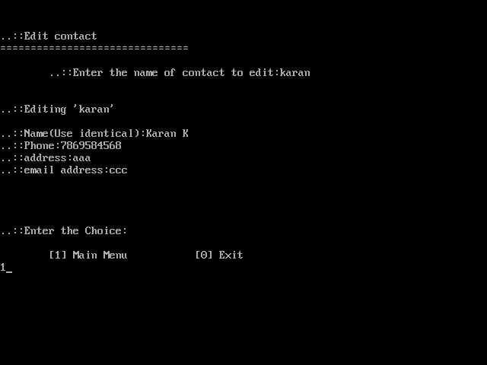
Contact Management System
Fig 3.4 Editing a Contact

Slide 14
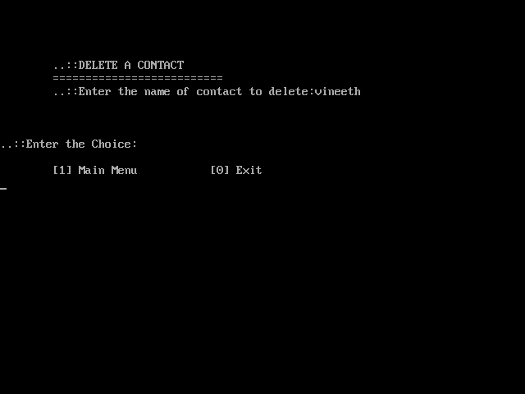
Contact Management System
Fig3.5 Deleting a contact

Slide 15
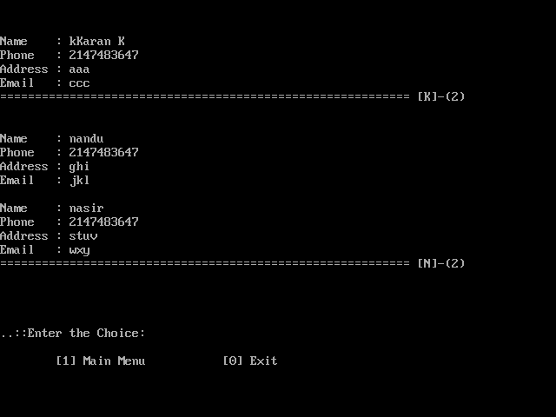
Contact Management System
Fig3.6Displaying of contacts after deleting.

Slide 16
Contact Management System
CONCLUSION:
This program makes the user simpler to connect to his contact. The contact personal information and family information is stored under a single number this would benefit the user to easily search and locate his required contact. This program deals with four operations of adding contacts, deleting them, modifying, searching according the user’s choice. Each operation is made as an individual function and so control enters to different structures and all the data added or modified or deleted is going to be stored in a .txt file using FILE pointers.

Slide 17
Contact Management System
FUTURE SCOPE:
In future one change can be done by adding the fingerprints of the persons of which the address is entered.And one more major change which can be done in this project is that to add the snaps of the person of which the address is entered.We can also add or subtract details of the individual.

